Slide 1
EES203: Geochemistry
Instructor: Anoop Ambili
Email id: anoop@iisermohali.ac.in

Slide 2
Proxies for paleohydrology
2
Notes:
2

Slide 3
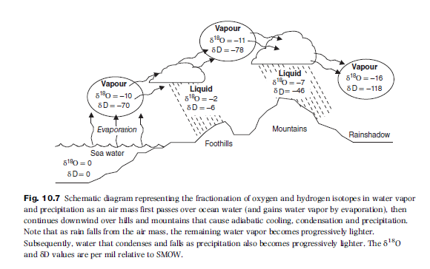

Slide 4
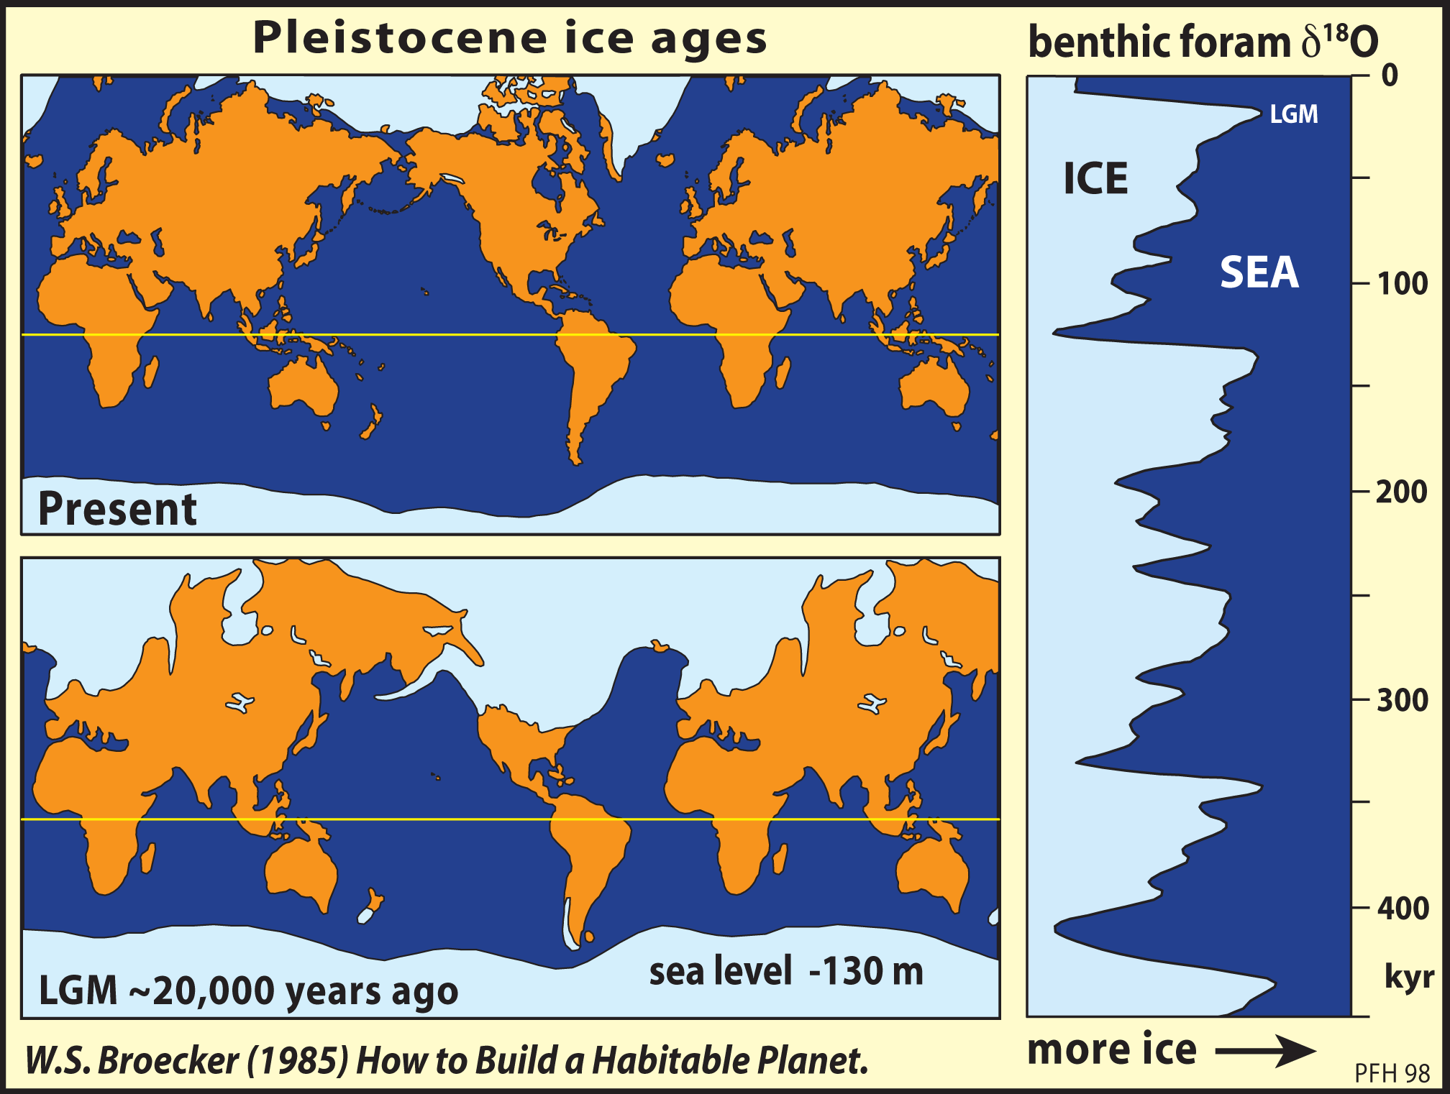
Enrichment

Slide 5
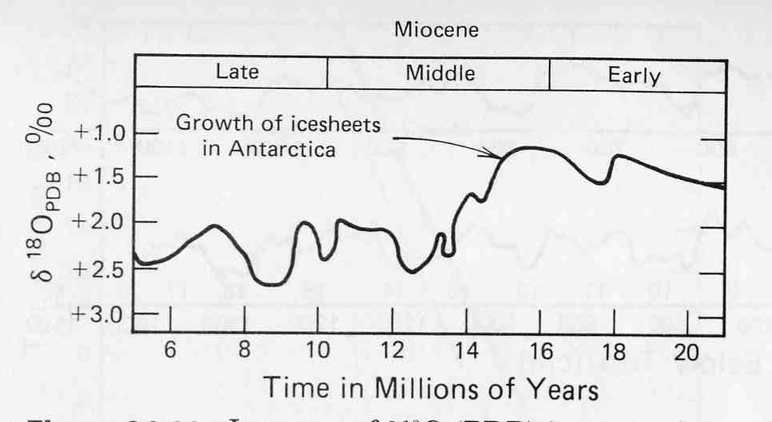
Paleothermometry in the oceans
Increase of δ¹⁸O in tests of a benthic foraminifer in a core collected in 2200 m of water in the equatorial Pacific. The increase in δ¹⁸O of the carbonate indicates a decrease in the temperature of bottom water at this site 16 Ma and was associated with the growth of continental ice sheets in Antarctica.

Slide 6
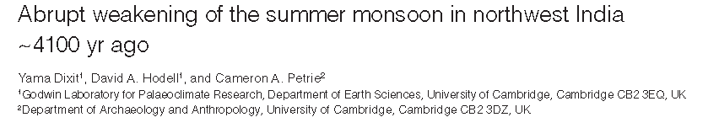
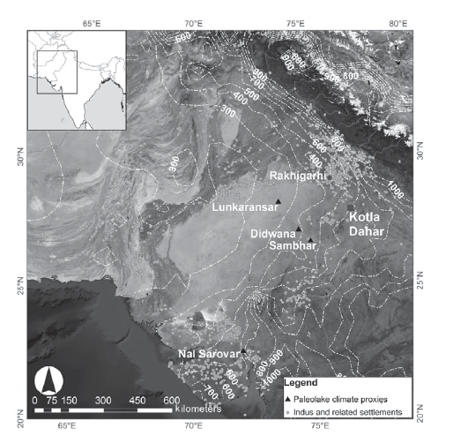

Slide 7
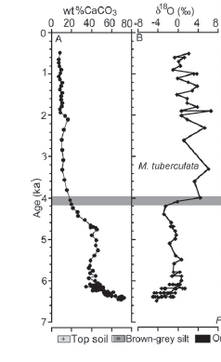
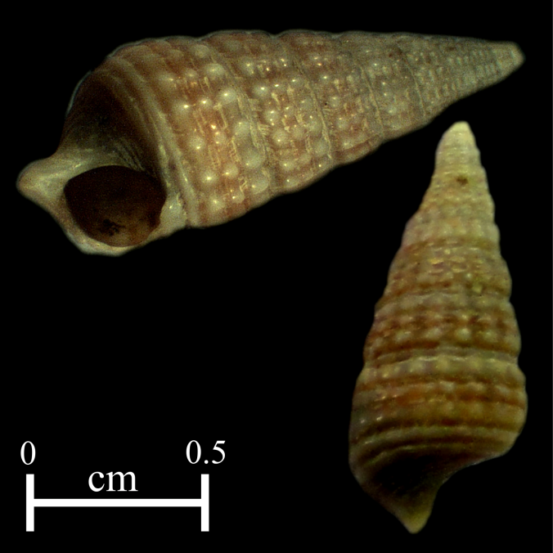

Slide 8
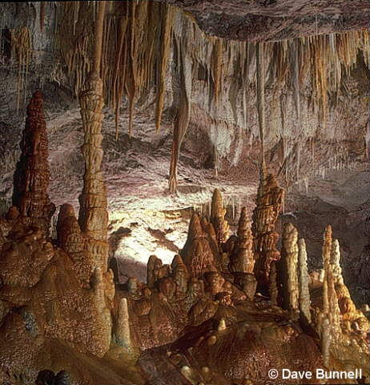
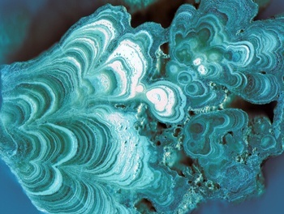
Speleothems
Calcium carbonate (CaCO₃ cave deposits
Grow on scale of 10’s of microns per year
δ¹⁸O used for paleoclimate reconstructions
The δ¹⁸O of speleothems is a reflection of the groundwater δ¹⁸O, and ultimately the δ¹⁸O of rainfall in the region

Slide 9
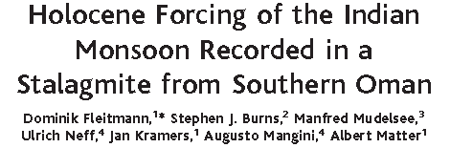
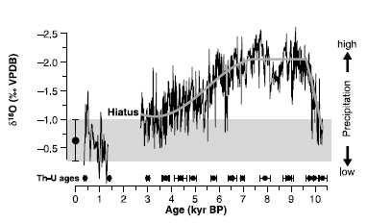
Fleitmann et al., 2003; Nature

Slide 10
Carbon isotopes
Notes:
Change date

Slide 11
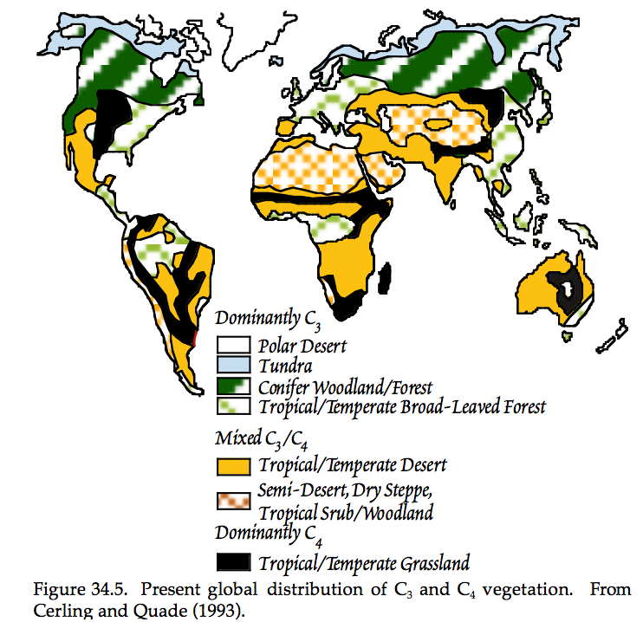

Slide 12
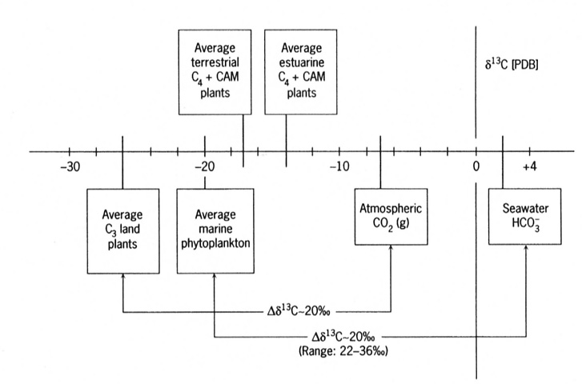
Case study: δ¹³C of bulk organic matter to determine source
C₄ = grasses Crassulacean acid metabolism, also known as CAM photosynthesis, is a carbon fixation pathway
that evolved in some plants as an adaptation to arid conditions

Slide 13
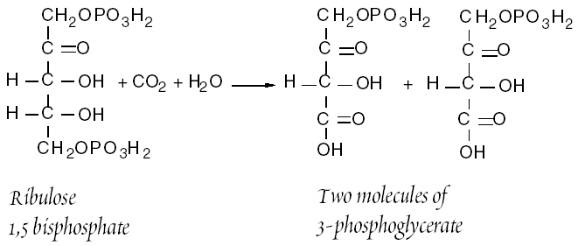
Photosynthesis
Terrestrial photosynthesis - theoretical calculations predict a 4.4‰
kinetic fractionation for CO₂(g) moving from air through stomata to site of
photosynthesis
C3 Pathway
enzyme-mediated
(RUBISCO)
-RUBISCO fixes 1 O₂
for every 5 CO₂
“Calvin” cycle
90% of all plants
20-30‰ fractionation
Notes:
Effective at grabbing CO2, not just kinetics

Slide 14
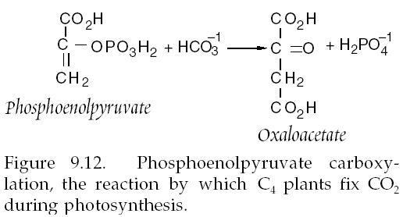
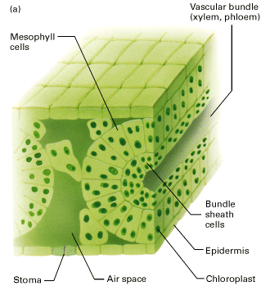
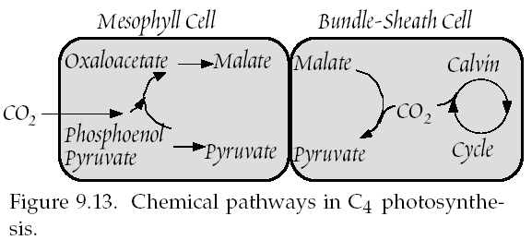
C4 Pathway
desert plants, some
tropical species
enzyme-mediated
(PEP)
“Hatch-Slack” cycle
10% of all plants
13‰ fractionation
NOTE: C4 plants still execute “Calvin”
cycle, but CO2 grabbing and actual
carbon fixation happening in different cells
Notes:
Separated in space (grab effective)

Slide 15
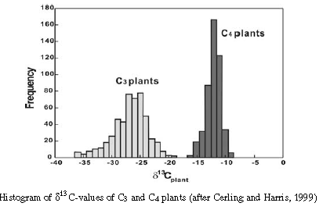
C₃ vs C₄ plants

Slide 16
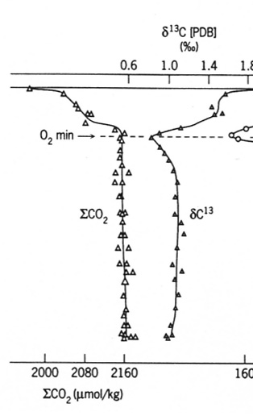
Case study: profiles of δ¹³C to estimate primary productivity
The profiles of δ¹³C can be used to estimate primary productivity
More photosynthesis in surface results in a heavier δ¹³C, resulting in a more positive δ¹³C in surface DIC
North Atlantic data

Slide 17
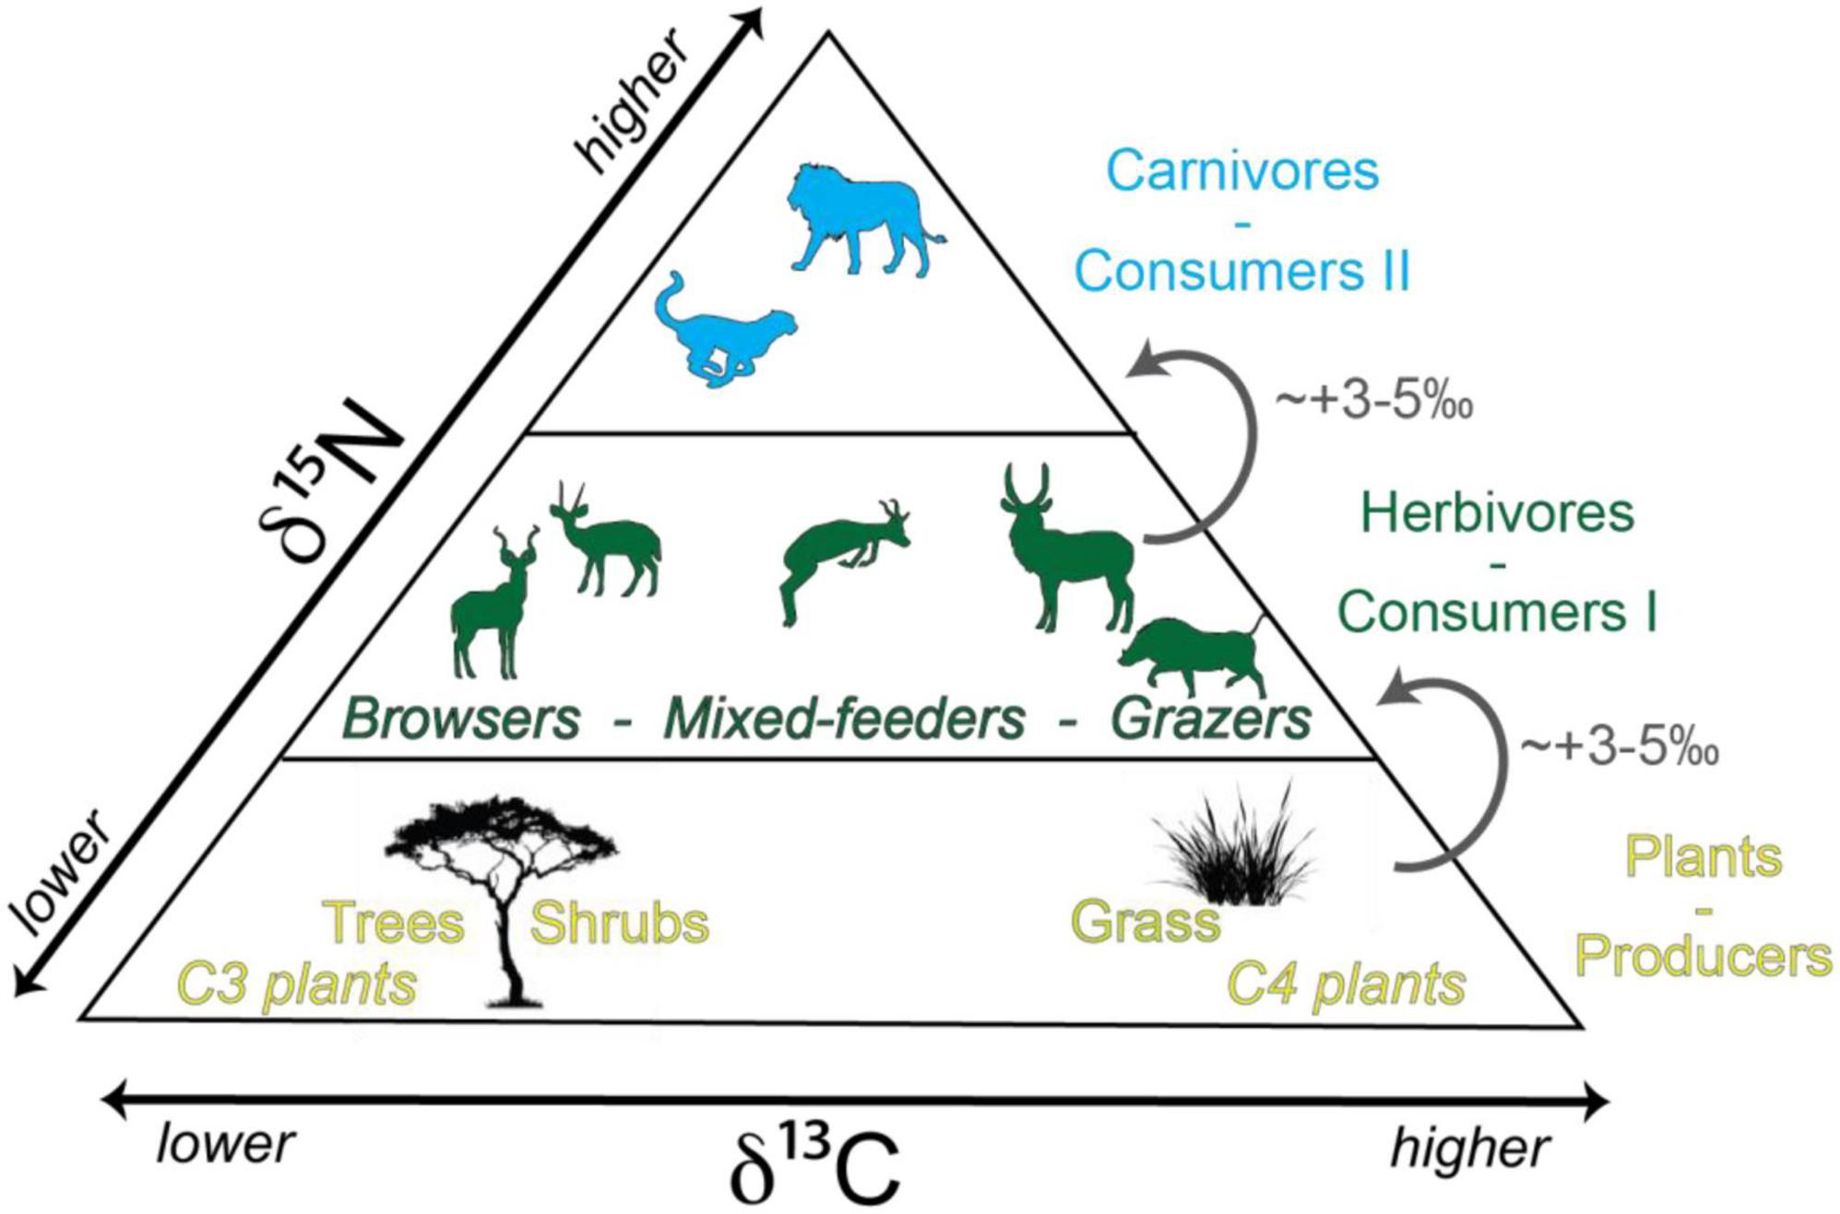
Information on “paleodiet”

Slide 18
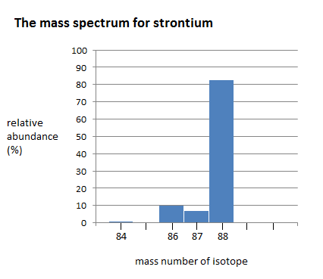
Isotopes of Strontium
The alkali earth metal strontium has four stable naturally occurring isotopes:
^{~84}Sr (0.56%)
^{~ 86}Sr (9.86%)
^{~87}Sr (7.0%) and
^{~88}Sr (82.58%)
Relative abundance (%)
Strontium isotopes
McArthur et al., 2012

Slide 19
Evolution of Strontium Isotope ratios
Fractionation of Rb/Sr between
upper mantle and continental crust
Evolution of ⁸⁷Sr / ⁸⁶Sr ratio from bulk earth ration since fractionation
Elderfield, 1985

Slide 20
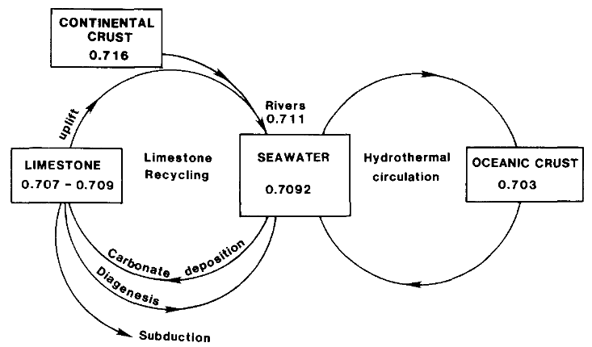
Geochemical cycle of strontium
Elderfield, 1985

Slide 21
Estimated values of Strontium Isotopes
Primordial ⁸⁷Sr/⁸⁶Sr ratio ~0.699
Strontium- depleted ocean basalts ~ 0.703
Strontium- enriched continental rocks ~0.701 to 0.740
Modern seawater has ⁸⁷Sr/⁸⁶Sr ~0.709

Slide 22
Applicability of Strontium for chemostratigraphy
Sr Ocean Residence Time (⁸⁷Sr): ~4 x 10⁶ yrs
Ocean Mixing Time: ~10³ yrs
Well-mixed with Sr at any point of time.
Negligible/near about absent effects of isotope fractionation
Absence of ⁸⁷Rb in carbonate phase

Slide 23
Strontium Isotope Stratigraphy
Strontium isotope stratigraphy relies on recognised variations in the ⁸⁷Sr/⁸⁶Sr ratio of seawater over time.
Using the more conventional biostratigraphic correlation techniques we can create high resolution stratigraphy of marine sedimentary sections.
⁸⁷Sr/⁸⁶Sr in a mineral precipitated from seawater, such as biogenic carbonate, micrite or a marine-derived evaporite, can be used to determine depositional age by comparison to a empirical calibrated curve of ⁸⁷Sr/⁸⁶Sr against time.

Slide 24
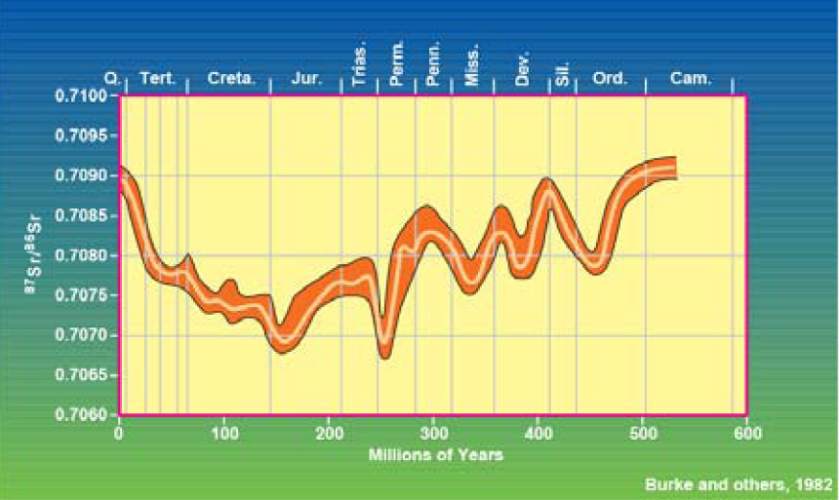
Change in Isotope ratio throughout Phanerozoic time
Veizer , 1989

Slide 25
Lowess curve and its use in Isotope Stratigraphy
LOWESS fit for the period 0-610 Ma with 95% confidence bounds. McArthur et al., 2001

Slide 26
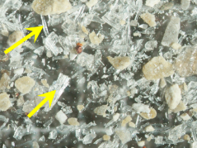
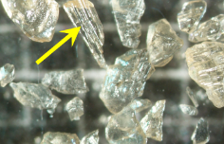
Ideal Materials for SIS
Samples must have high potential for retaining their original marine strontium isotope ratios.
High registance to Diagenesis.
Shells of Mg Calcitic composition yields narrow uncertainty bands.
Secondary Alteration are found and diagnosed beforehand to avoid mistaken results.
Foraminiferal , Belemnite Guards and Bivalve Shells etc.
Bivalve shell
Belemnite

